Slide 1

Garment Productivity Analysis
DATA 201 Spring 2026 | Regression Focus Project

Slide 2
Predicting Industrial Performance
Utilizing the UCI Machine Learning Database to build, evaluate, and improve regression models targeting productivity outputs in the garment manufacturing sector of Bangladesh.

Slide 3

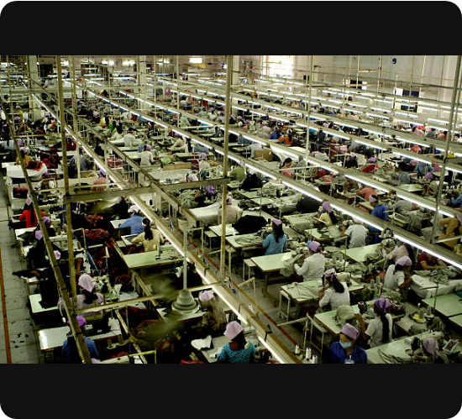
The Garment Dataset
Source: UCI Machine Learning Repository (2020)
Population: Manufacturing teams in sewing and finishing departments.
Size: 1,197 total observations representing daily summarized outputs.
Target: Actual Productivity — A continuous quantitative variable ranging from 0.0 to 1.1+ (exceeding targets).

Slide 4
Core Variable Matrix
Variable | Type | Description
actual_productivity | Target | Actual % of productivity delivered (0-1).
targeted_productivity | Quantitative | Targeted productivity set by authority.
smv | Quantitative | Standard Minute Value: task complexity.
department | Categorical | Associated department (Sewing vs Finishing).
incentive | Quantitative | Financial motivation in BDT.

Slide 5

Ensuring Data Integrity
Cleaning was essential for valid modeling:
WIP Imputation: Filled 40% missing values with 0.
String Strip: Standardized "finishing " and "sewing" labels.
Encoding: Converted categories to one-hot binary features.

Slide 6

Exploratory Data Analysis
Uncovering patterns before model construction

Slide 7






Industrial Insights
The Dept. Divide
Target Concentration
Sewing Outliers
Finishing tasks are short (Low SMV) while Sewing tasks range up to 55+ minutes in complexity.
The majority of teams cluster around a 0.80 performance band, regardless of complexity.
Sewing is more consistent in the median but suffers from extreme low-end productivity outliers.

Slide 8
Baseline Regression Model
0.166
Simple Linear Model
Features: SMV, Incentive, Team, Department, Targets.
This model assumed task complexity affected every department identically—a limitation we aimed to fix.
R-Squared (Baseline)

Slide 9
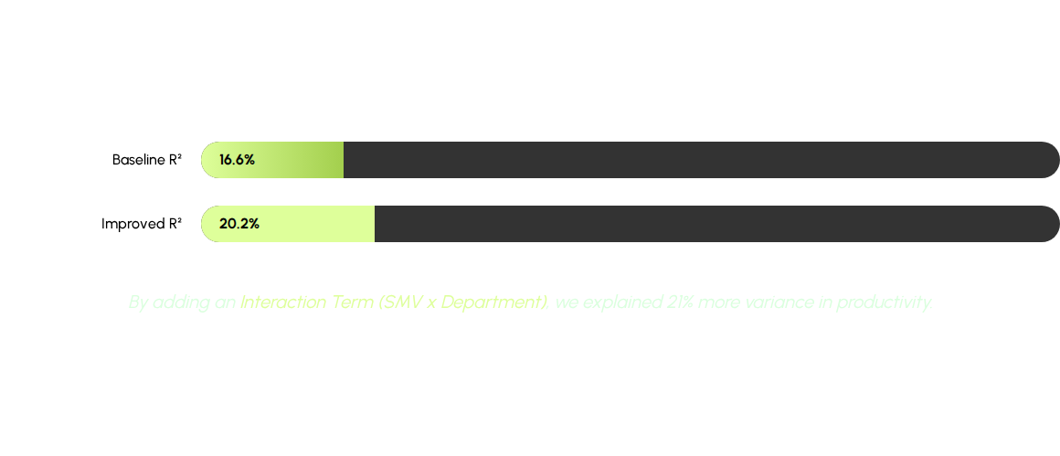
Improving Model Accuracy

Slide 10

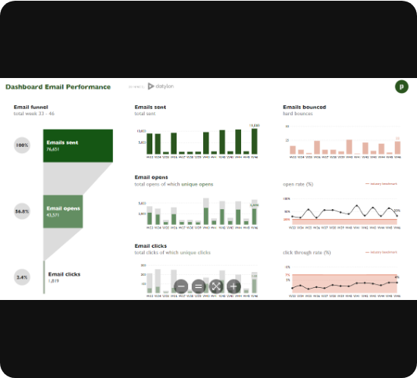
Coefficient Interpretation
+0.749 — Targeted Productivity: High authority expectations drive actual results.
-0.068 — Interaction Term: Complexity penalizes Sewing more than Finishing.
+0.000058 — Incentives: Small positive impact on overall motivation.

Slide 11



Predictive Scenarios
High Motivation
Standard Sewing
High Complexity
1.87
0.84
0.67
Predicted for Finishing teams with high financial incentives.
Predicted for basic Sewing tasks without additional incentive.
Complexity penalty reduces output in Sewing despite high incentives.

Slide 12


Questions?
Garment Productivity Analysis | DATA 201

Slide 13




Image Sources
https://media.istockphoto.com/id/147032302/photo/garment-factory_1.jpg?s=612x612&w=0&k=20&c=86knWsq1Xn1zpbGxLyt3QnQX9EKZstCWAIxK3J-fRhk=
Source: www.istockphoto.com
https://media.istockphoto.com/id/507212963/photo/tailor-at-work-on-sewing-machine.jpg?s=612x612&w=0&k=20&c=mBcv2VzKR3vH9dn7_Bhpq6e6uU2yUCWVierQWh0efqY=
Source: www.istockphoto.com
https://www.datylon.com/hs-fs/hubfs/Datylon%20Website2020/Blogs/The%205%20Best%20Data%20Visualization%20Dashboards/datylon-blog-The-5-Best-Data-Visualization-Dashboards-Exploring-Automated-Reporting-Solution-image1.png?width=1200&height=639&name=datylon-blog-The-5-Best-Data-Visualization-Dashboards-Exploring-Automated-Reporting-Solution-image1.png
Source: www.datylon.com
https://slidebazaar.com/wp-content/uploads/2022/12/business-icons-for-ppt-jpg.webp
Source: slidebazaar.com

